Slide 1
Cat Hub Webpage
Zhen Pan(231AHG002)
Zhen.Pan@edu.rtu.lv
gracepan922@gmail.com
Webpage: https://grace128pan.github.io/programmingProject1/
Github raw materials: https://github.com/Grace128pan/programmingProject1

Slide 2
About
Cookies & Navigations & Input and Buttons & Links & Ads
Layout & Navigations
Navigations & Input & Buttons & Calculations
calorie.html & calorie.css & calorie.js
index.html & styles.css & script.js
cat.html & cat.css

Slide 3
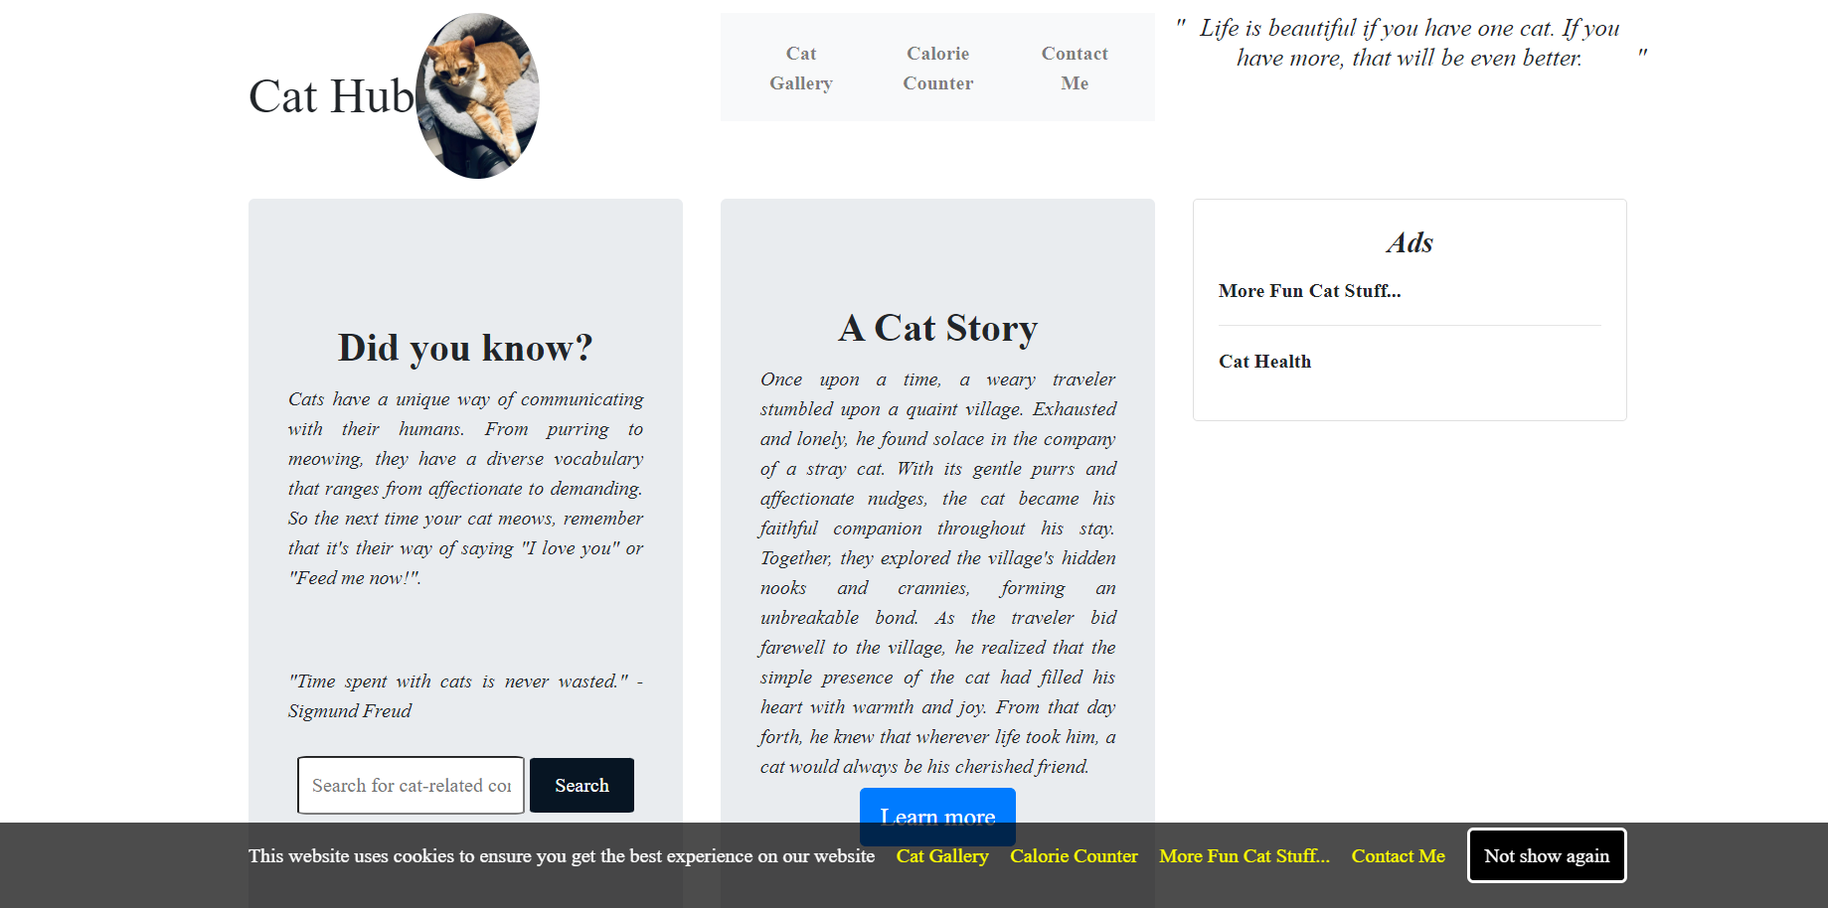
index.html

Slide 4
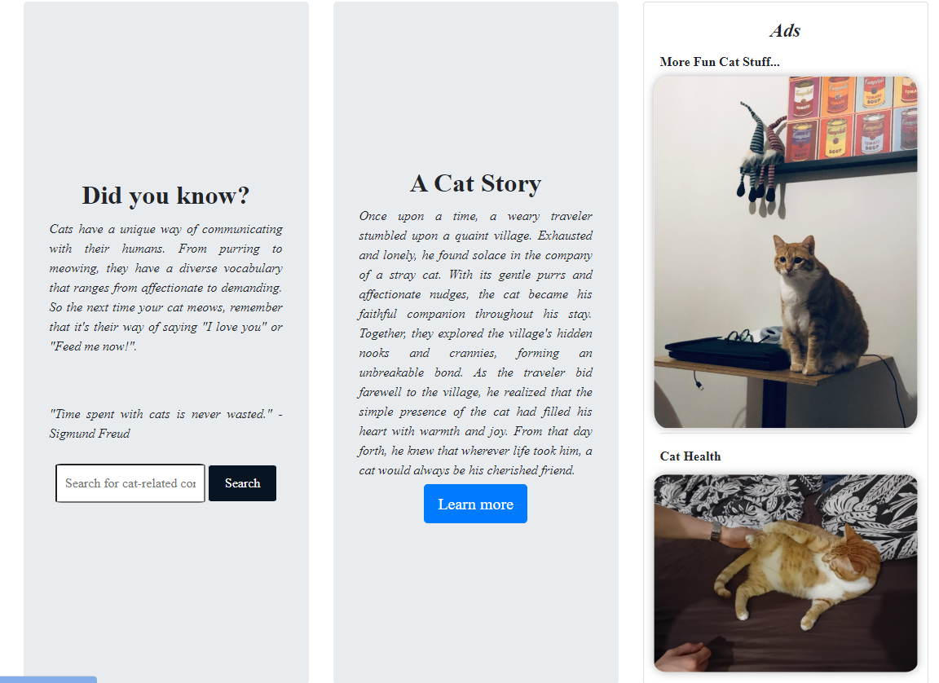
index.html

Slide 5
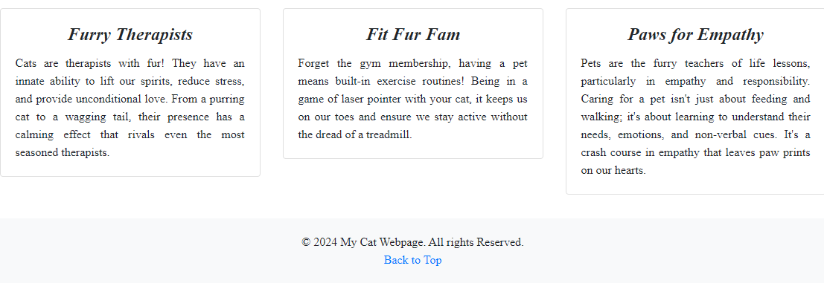
Index.html

Slide 6
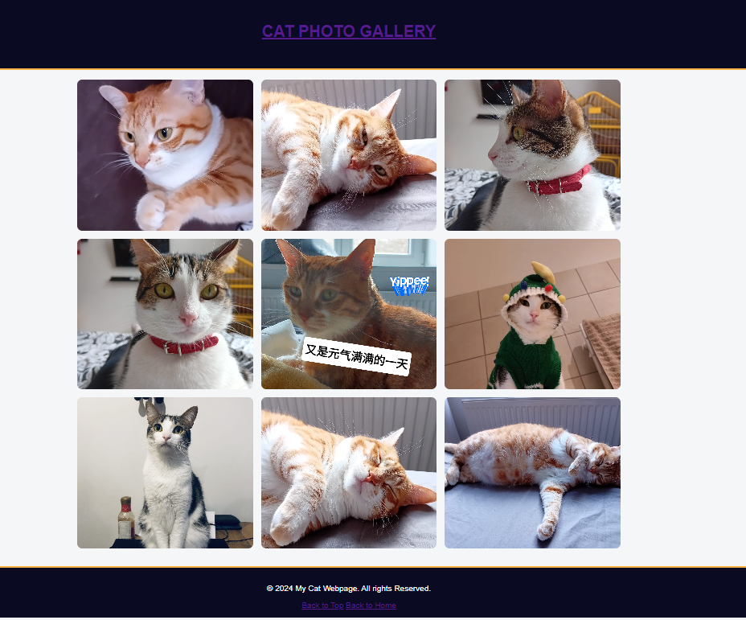
cat.html

Slide 7
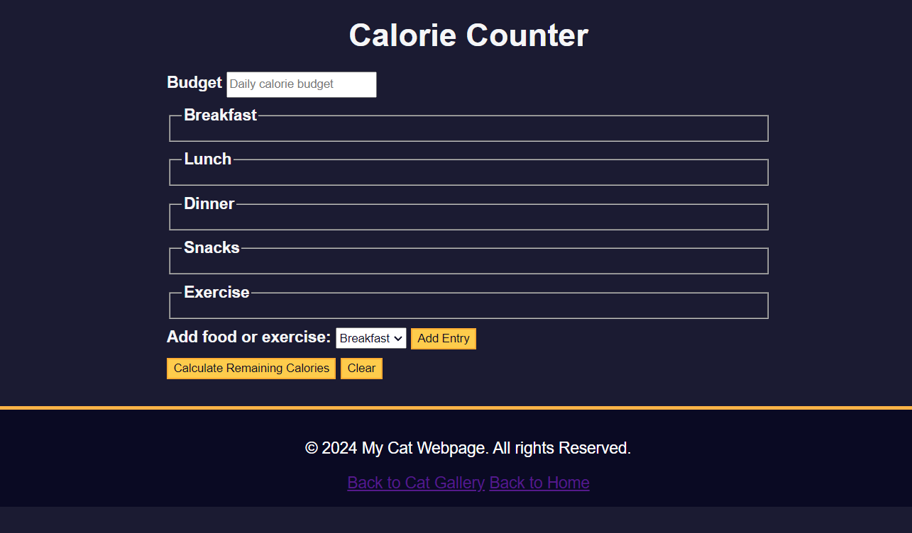
calorie.html

Slide 8
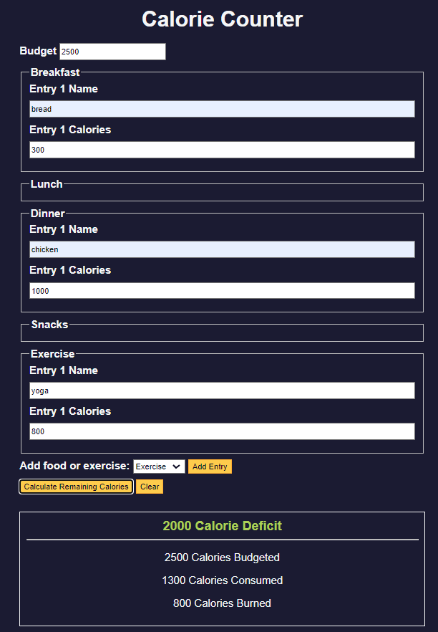
calorie.html

Slide 9
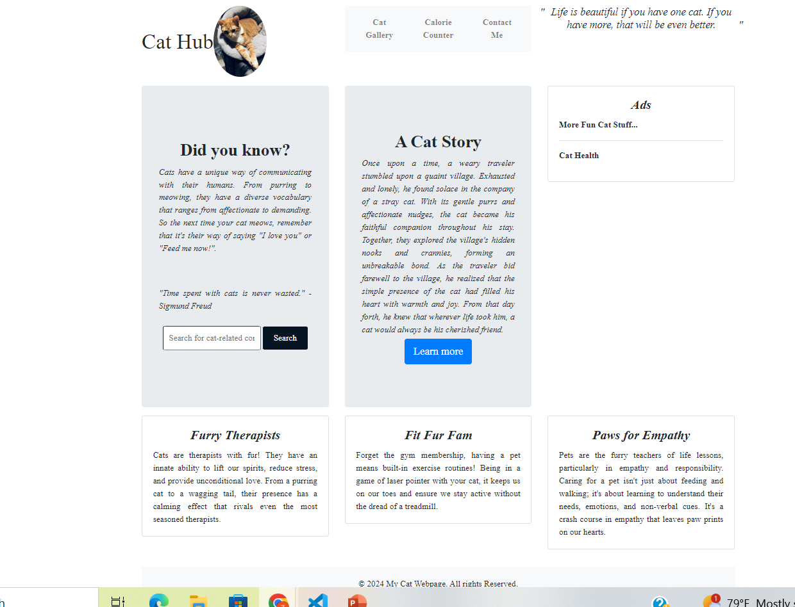
Responsive to Screens

Slide 10
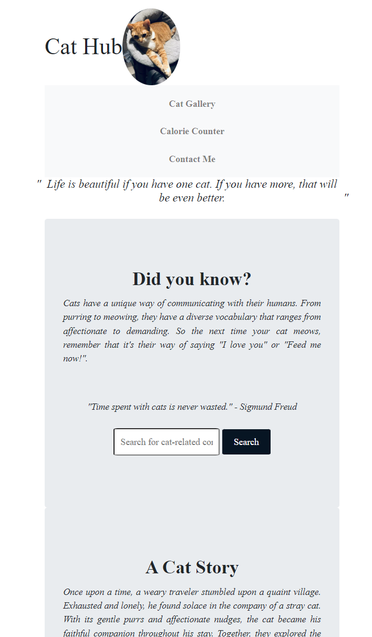
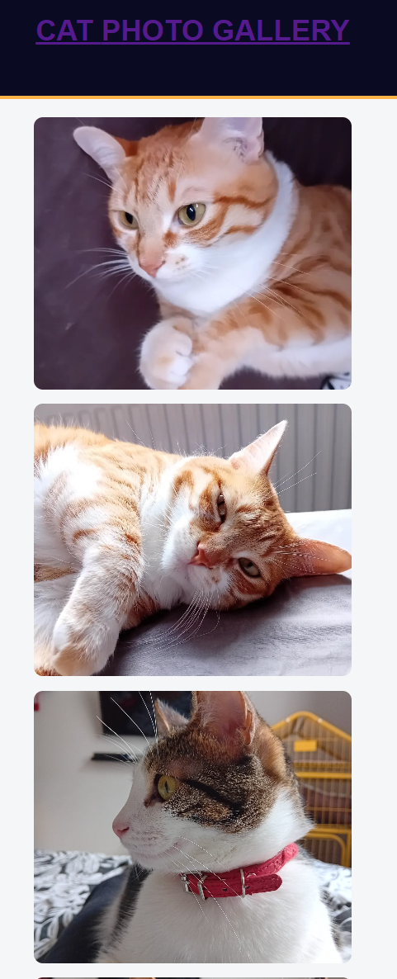
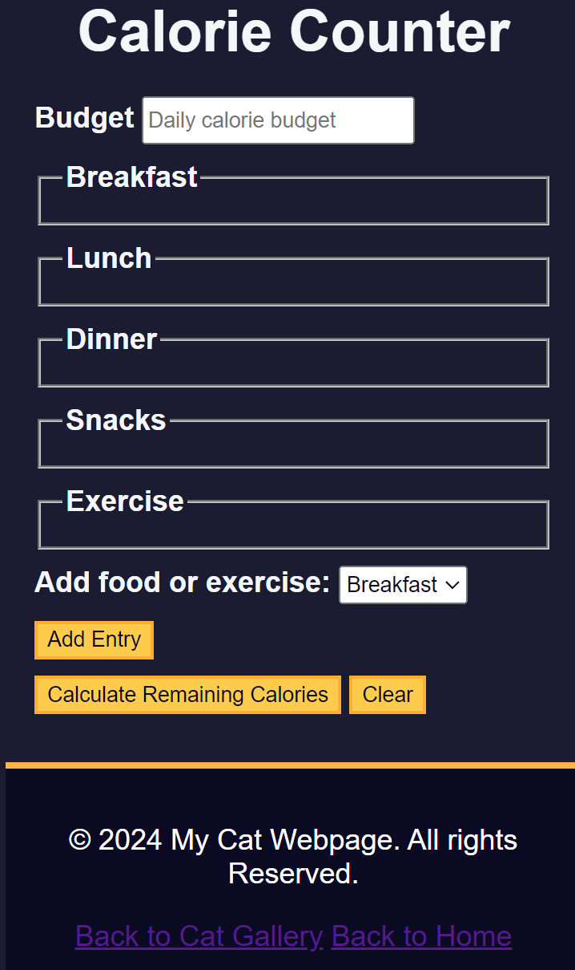
Responsive to Screens

Slide 11
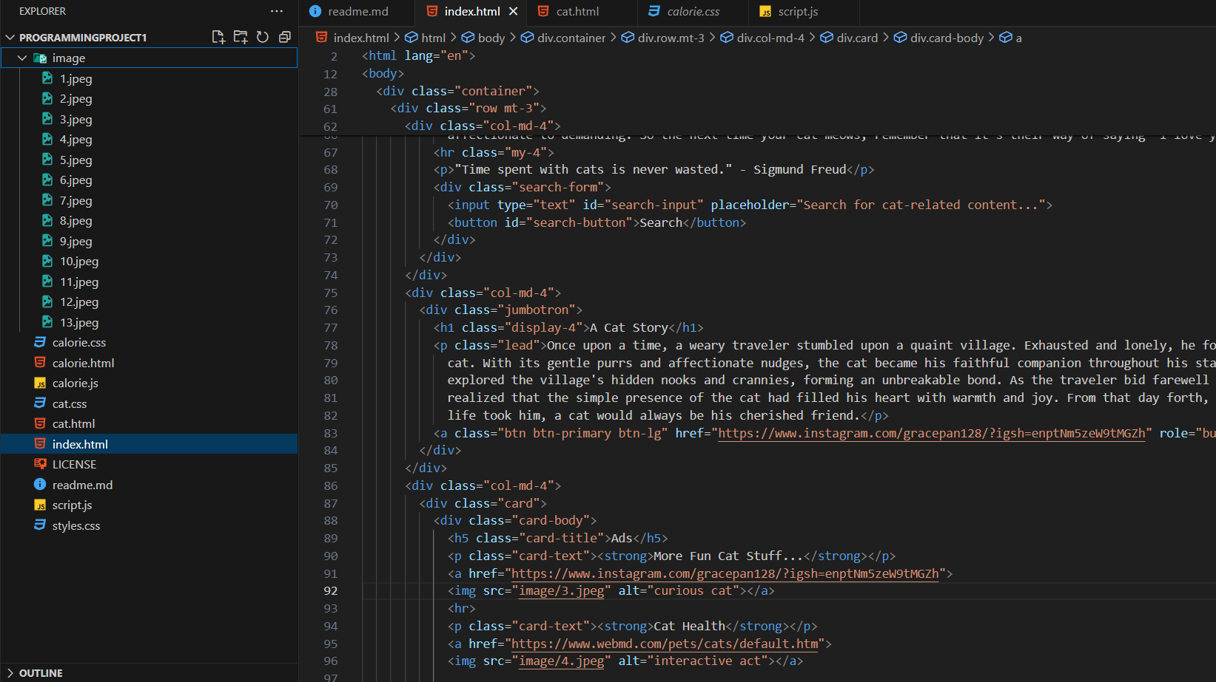
Efforts Display

Slide 12
Conclusions
Meet Requirements
Functionalities
Layout
FurtherMore
More Interactive Design
Audio and Visual effects
In-depth Contents
Required multiple files and pages
Use bootstrap and flex for better layout and screen responsiveness
1. Navigation
2. Buttons
3. User Input
4. Calculations
5. Cookies
Multiple colors
Content consistency

Slide 13
Thank you for your patience!
Raw Data sources from my github:
https://github.com/Grace128pan/programmingProject1
My webpage: https://grace128pan.github.io/programmingProject1/

